Slide 1
Control Analysis
Based on APM flight logs from 15-11-08 and 15-11-09 test flights

Slide 2
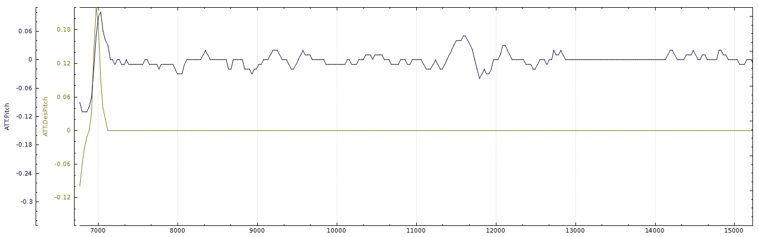
Pitch

Slide 3
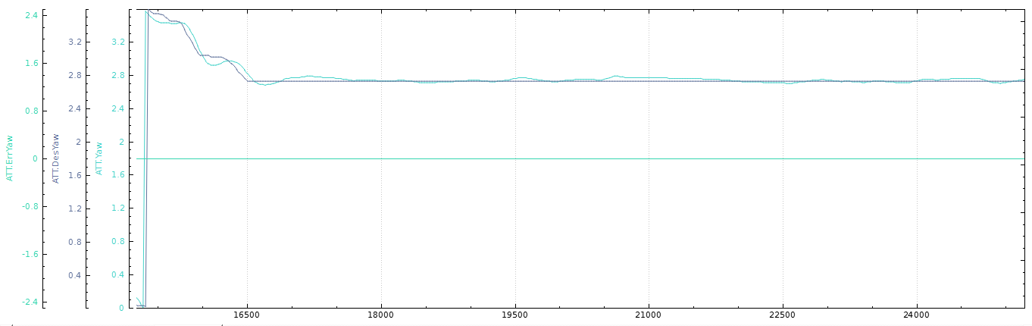
Yaw

Slide 4
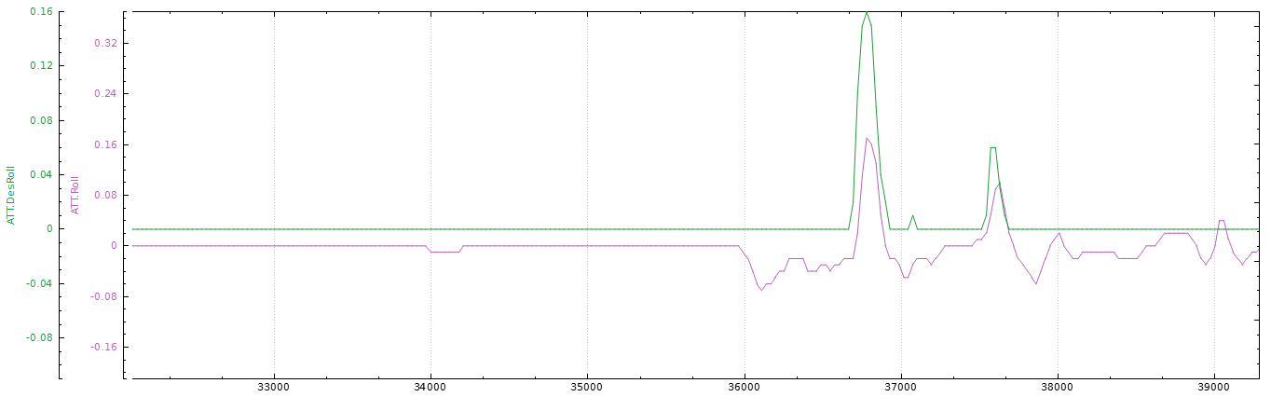
Roll

Slide 5
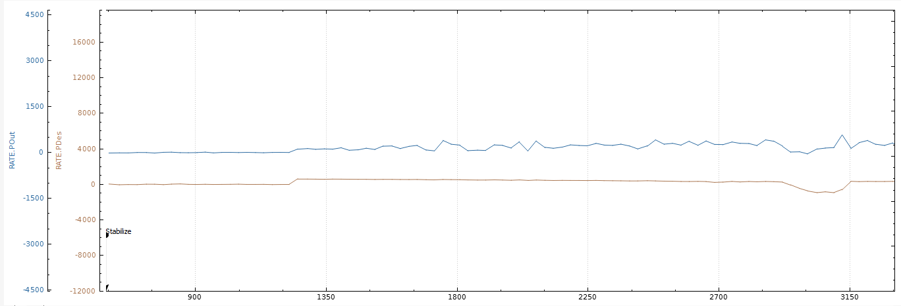
Pitch Rate

Slide 6
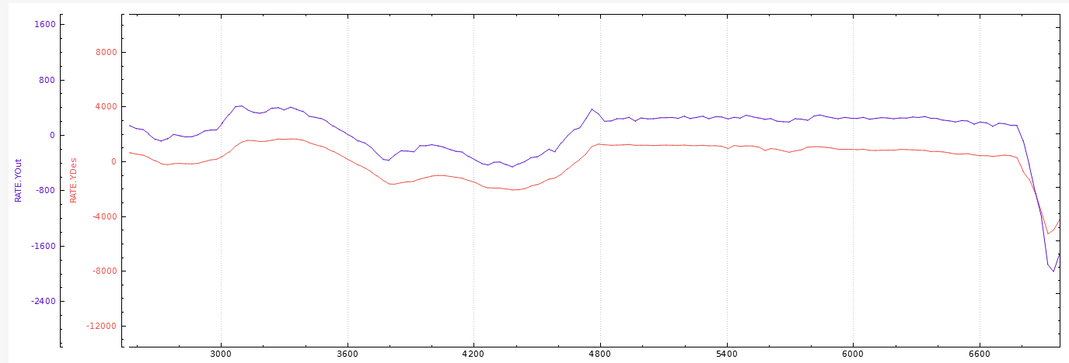
Yaw Rate

Slide 7
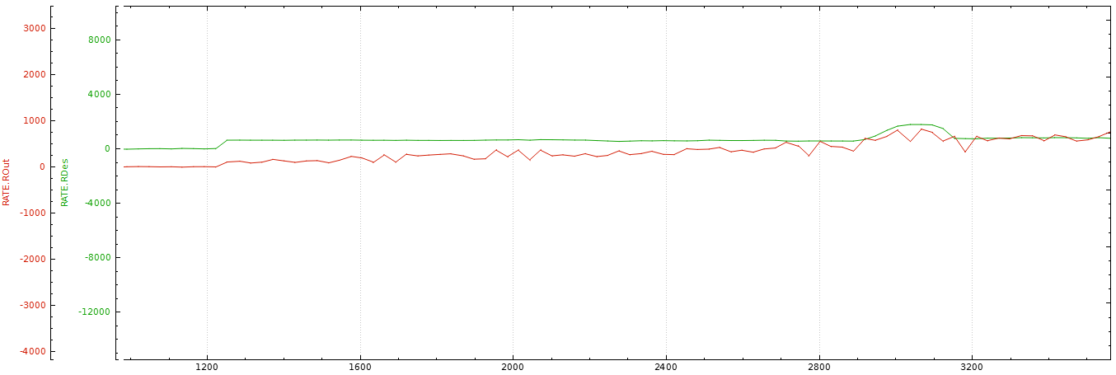
Roll Rate

Slide 8







Current Control Tuning Parameters

Slide 9
Possible causes of Steady State Errors Despite Integral Action
Error caused by actuators windup effect.
Integral time is too short.
Hardware issues.

Slide 10
Goals
Improve tuning of pitch rate and yaw rate controllers to eliminate steady state error.
Perform HIL and SIL simulations with the parameters obtained.

